Slide 1
Impact Evaluation of Ethiopia’s Productive Safety Nets Program 2010
Guush Berhane
John Hoddinott
Neha Kumar
Alemayehu Seyoum Taffesse
IFPRI
BASIS/USAID September 30, 2011

Slide 2
Outline
Study Objectives
About PSNP
Impact Methodology
Data
Impact Results
Average impact
Regional Variation
Summary of other results
Future work

Slide 3
PSNP Evaluation 2010- Study Objectives
Document progress in the implementation of the PSNP and the HABP (Household Asset Building Program);
Assess trends in perceptions of the effectiveness and transparency of the PSNP and HABP among different groups of clients;
Assess progress towards graduation from the PSNP among different groups of PSNP clients; and
Measure the impact of the PSNP on the well-being of the chronically food insecure population;
Measure the complementary roles played by the PSNP and HABP in achieving positive outcomes for the food insecure.
Mixed methods were employed- the IFPRI team lead the quantitative analysis and the IDS team lead the qualitative analysis.
Geographical focus: highland areas: Tigray, Amhara, Oromiya and SNNPR; lowland areas: Somali and Afar

Slide 4
PSNP
1993-2004, GoE launched near annual emergency appeals for food aid.
These averted mass starvation
But did not alleviate threat of further famine
In 2005, the Food Security Program (FSP) was implemented by GoE and a consortium of donors as a new response to chronic food insecurity in rural Ethiopia.
Objectives of the FSP
Provide transfers to food insecure population in chronically food insecure woredas
Prevent asset depletion
Create community assets
Components of FSP we study:
PSNP -> Public works and Direct Support
HABP
No pilot. Implemented at scale. Currently covers about 7 million people.

Slide 5
Methodology for Evaluating the Impact of the PSNP (1)
Since PSNP was not implemented randomly
simple comparison of mean outcomes between beneficiary and non-beneficiary households will give a biased estimate of impact.
In earlier evaluations of the PSNP we address this bias
by constructing a comparison group for the evaluation by matching PW beneficiaries to households that did not take part in PW based on observable household and community characteristics.
The impact of PW is estimated as the (weighted average) difference in outcomes between PW beneficiaries and the matched sample of nonbeneficiaries.

Slide 6
Methodology for Evaluating the Impact of the PSNP (2)
These matching methods suffer from some limitations that have become increasingly important over time:
Rely on construction of a comparison group who, even though have comparable characteristics, do not receive PSNP benefits.
There has been considerable movement in and out of PSNP as a result the group that never received transfers is rather small
These households are observably different from PSNP beneficiaries- if they have never been deemed sufficiently food insecure in the six year period to warrant inclusion in the program

Slide 7
Methodology for Evaluating the Impact of the PSNP (3)
These matching methods suffer from three limitations that have become increasingly important over time (continued):
It has not been possible to estimate the impact of Direct Support transfers using matching methods.
There are not enough households that have characteristics similar to DS beneficiaries but do not receive any transfers from the PSNP (PW or DS)
With PSNP now in its sixth year of operation, there are now some households that have received transfers that run into 1000s of birr.
It would be useful to understand if there are diminishing, or increasing, impacts associated with higher levels of transfers. This is not possible with matching methods used in previous evaluations.

Slide 8
Methodology for Evaluating the Impact of the PSNP (4)
We employ an alternative approach which allows us to assess the impact of the level of transfers on outcomes of interest.
Level of transfers received is not random: households that receive high level of transfers may be very different from households that receive low level of transfers.
The “dose-response function” addresses this problem of comparability by adjusting for differences in household characteristics (such as head’s age, gender, education, household size and composition, household assets and variables that capture social position) between households receiving different levels of transfers.

Slide 9
Methodology for Evaluating the Impact of the PSNP (5)
Outcome measures presented today:
Change in food gap
where food gap is defined as the number of months in the last year a household was unable to fulfill its food needs.
Change in food gap= Food gap₂₀₁₀ - Food gap₂₀₀₆
Change in Tropical Livestock Units held
TLU- method of quantifying a wide range of different types of livestock in a standardized manner.
Change in TLU= TLU₂₀₁₀ - TLU₂₀₀₆

Slide 10
Data
The first large-scale PSNP evaluation survey was fielded in 2006. Its design was based on discussions by relevant Government of Ethiopia actors (FSCB/FSCD, CSA) and donors with technical support from IFPRI. The sample is representative of chronically food insecure woredas at the regional level as of April 2006.
Regions covered- Tigray, Amhara, Oromiya and SNNPR
Panel of 3700 households surveyed in 2006, 2008 and 2010
Survey timing across rounds have been comparable
Attrition is 2.5 percent per year; average by international standards for panel data collection. Attrition is basically random.

Slide 11
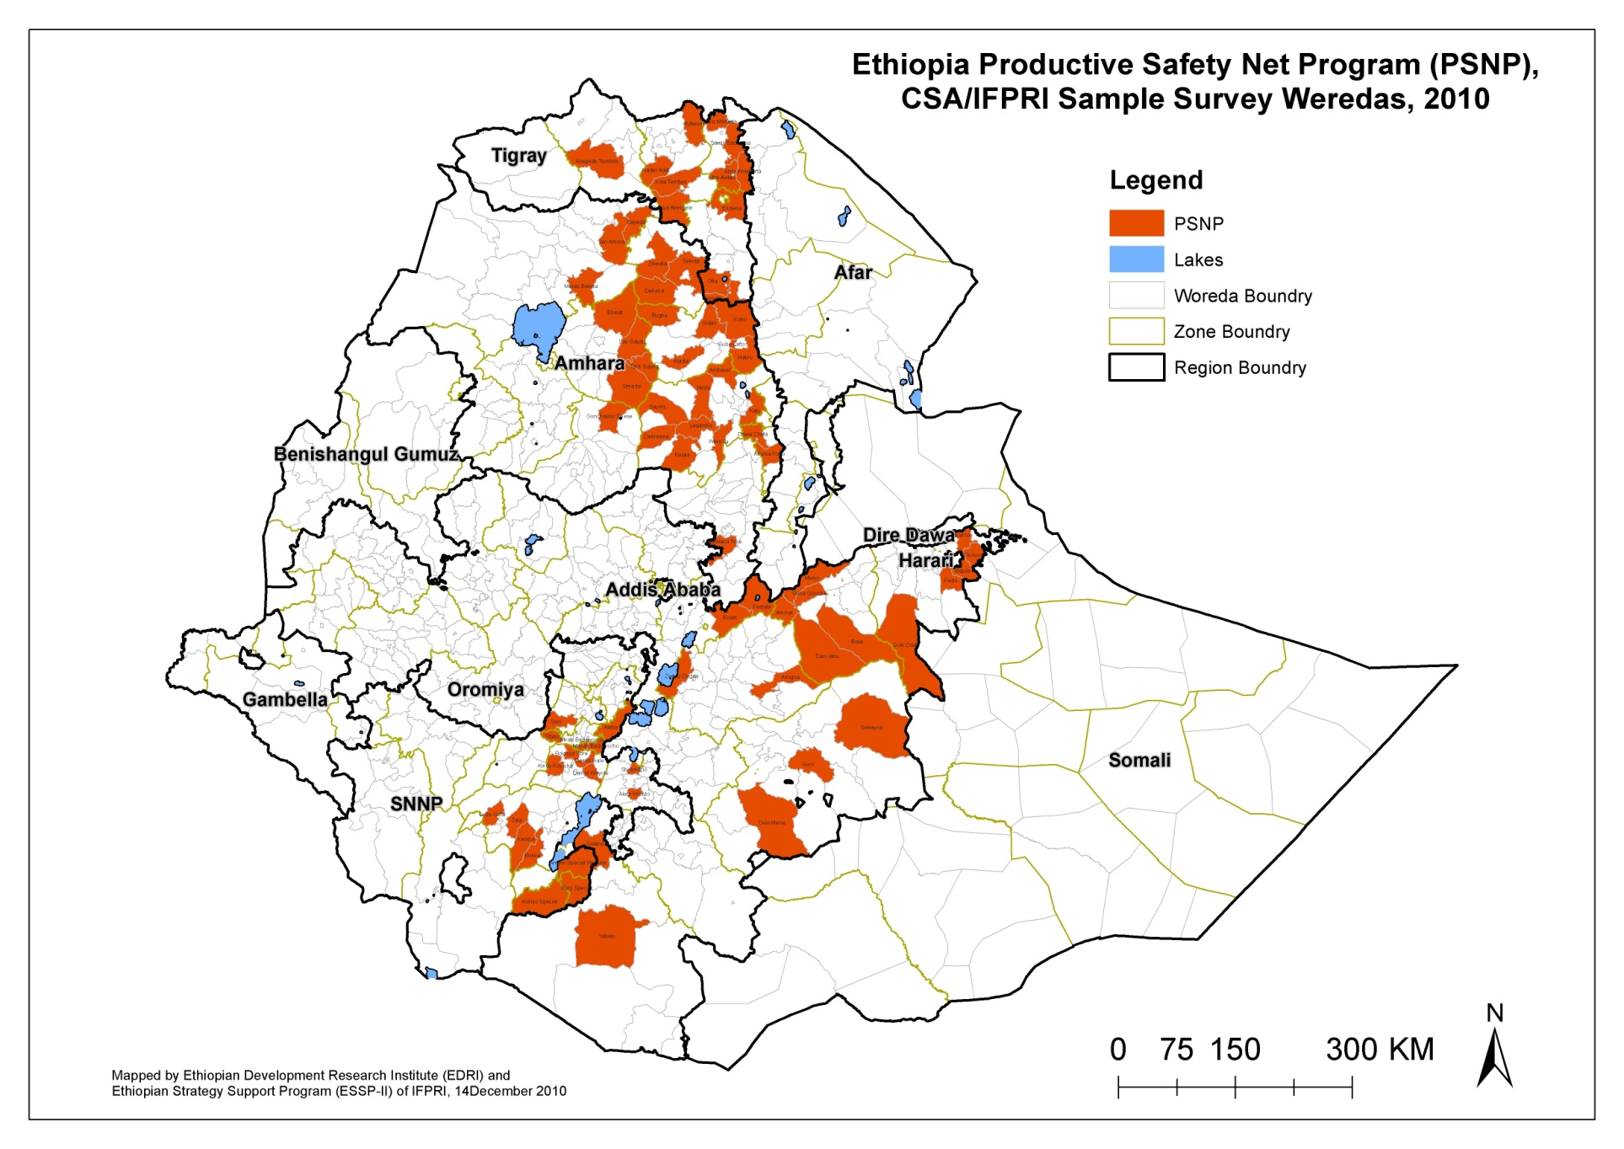
s

Slide 12
Some payment data issues
The 2006, 2008 and 2010 surveys give us payments data (cash and in-kind) for the following periods:
January - May 2006
January 2007 – May 2008
January 2009 – May 2010.
We value in-kind transfers at prevailing (local) market prices and add these values to cash payments received to generate the amount of total payments received over this period.
To account for inflation, we deflate transfers by regional Consumer Price Indices (CPI) so that all transfers are expressed in June 2006 Birr.
We limit the sample to households that have received PSNP payments for Public Works in at least two years between 2006 and 2010. This is appropriate given that the objective of the PSNP is to provide transfers to households on a multi-year basis.

Slide 13
Distribution of PW payments: January 2006 – May 2010 (real 2006 Birr)

Slide 14
Impact of public works payments

Slide 15
Dose-response function for Public Works transfers and changes in the food gap, 2006-2010

Slide 16
Predicted impacts by transfer level: Changes in food gap and TLU
Transfer level | Food Gap | TLU
500 | -0.369 | 0.143
1000 | -0.775** | 0.427**
1500 | -0.918** | 0.547**
1750 (median) | -0.881** | 0.530**
2000 | -0.796** | 0.473**
2500 | -0.603** | 0.311**
3000 | -0.567** | 0.209
4000 | -1.082** | 0.362*
5000 | -1.729** | 0.666**

Slide 17
Regional differences in impact of PW transfers on changes in the food gap
Transfer Level | Tigray | Amhara | Oromiya | SNNPR
500 | -1.188** | -0.058 | -0.507 | -1.066
1000 | -1.385** | -0.518 | -0.543* | -0.915
1500 | -1.517** | -0.447 | -0.330 | -0.703*
2000 | -1.587** | -0.084 | -0.048 | -0.500*
2500 | -1.644** | 0.020 | 0.041 | -0.408**
3000 | -1.737** | -0.173 | -0.126 | -0.477**
4000 | -2.052** | -0.646 | -0.670 | -0.842**
5000 | -2.395** | -1.052 | -0.986 | -1.024

Slide 18
Regional differences in impact of PW transfers on changes in TLU
Transfer Level | Tigray | Amhara | Oromiya | SNNPR
500 | -0.303 | 0.529 | 0.375 | 1.175
1000 | -0.096 | 0.761** | 0.598** | 1.394*
1500 | -0.026 | 0.520* | 0.430* | 1.534**
2000 | -0.114 | 0.070 | 0.095 | 1.439**
2500 | -0.281 | -0.106 | -0.026 | 1.094**
3000 | -0.411 | -0.021 | 0.206 | 0.721**
4000 | -0.407 | 0.162 | 1.043 | 0.745**
5000 | -0.270 | 0.264 | 1.641* | 1.303**

Slide 19
Accounting for these regional differences
Note the following results from the descriptive report

Slide 20
Frequency of payments (percent), January-May
2009
2010
# payment | Tigray | Amhara | Oromiya | SNNPR
1 | 22.4 | 33.3 | 31.9 | 3.3
2 | 21.9 | 25.3 | 24.6 | 5.5
3 | 10.4 | 13.1 | 27.5 | 13.2
4 | 13.1 | 7.1 | 8.7 | 16.5
5 | 32.2 | 21.2 | 7.2 | 61.5
# payment | Tigray | Amhara | Oromiya | SNNPR
1 | 32.3 | 34.5 | 60.3 | 4.6
2 | 23.7 | 39.1 | 20.6 | 15.9
3 | 27.3 | 16.1 | 14.3 | 28.4
4 | 9.1 | 5.7 | 3.2 | 22.7
5 | 7.6 | 4.6 | 1.6 | 28.4

Slide 21
Accounting for these regional differences
Why low impact in Amhara and Oromiya?
Generally, transfer levels are lower
Payments are lumpy (see previous slide)
Payments are unpredictable
Long lags between work and payment
Short notice (typically one day) that payment is coming
Why difference between Tigray and SNNPR?
Possibly because of differences in transfer modality
Differences in the initial level of food insecurity. In 2006:
More than 30 percent of Tigrayan households had food gap > 4 months
Just under 10 percent of SNNPR households had food gap > 4 months
Recent discussions with officials in Tigray revealed that they advised against accumulating too many animals. Favored raising few but well. (Issues with over grazing)

Slide 22
Summary of Other impact Estimates: 2006-2010
Comparing cash and in-kind transfers
In-kind transfers protected households from food insecurity more than cash transfers. At median transfer the food gap went down by 1.5 months
Cash transfers, but not in-kind transfers, helped accumulate livestock
Comparing male and female headed household
At equivalent levels of transfers:
Asset accumulation is higher in male headed households
Reductions in food insecurity are greater in female headed households
Impact of Direct Support
We have some evidence that Direct Support payments are reducing food insecurity
Impact of PW payments + OFSP/HABP
OFSP/HABP + PW appears to have a larger effect on reducing the food gap than PW by itself

Slide 23
Summary of impacts: 2006-2010
For a “typical” beneficiary household (ie one receiving median transfers between 2006 and 2010), the impact of receiving PW transfers is to:
Reduce food insecurity by 0.9 months
Increase livestock holdings by the equivalent of one TLU
But these “typical” findings mask important heterogeneity in these data:
In SNNPR, PW PSNP leads to reduced food insecurity and increased asset holdings
In Tigray, PW PSNP leads to large reductions in food insecurity but little change in asset holdings
In Amhara and Oromiya, there is no impact on food insecurity and some impact on asset holdings

Slide 24
Future work…
Measure impact on more outcomes:
Consumption expenditures
Calorie availability
Agricultural productivity
Use of fertilizers and investment in water harvesting/soil conservation technologies
Anthropometric outcomes
Examine the average treatment effect of any PW transfers received (with/without treatment effect)

